Slide 1

On The Go Shop
Haifa University – computer Science project
Developers: Karam Abu Alhija, Ibrahem Igbaria.
Guide: Yossi Ben-Asher

Slide 2
Table Of Contents
Introduction
Android App
Server

Slide 3
Introduction
On the go shop is an app to manage a virtual shop.
Virtual shop: is a shop that doesn’t have any stores.
The stores are cars that keep wondering in the city.
As a user you can make an order choose the location you want, and you will get your order to you with no problem.

Slide 4
Technology we used
The app is made of two pieces of code a backend and a frontend.
The frontend is an android app that was developed by using android studio.
The backend is a java application that use spring boot.
Spring Boot is an open source Java-based framework used to create a micro Service.
MS SQLServer as Database.

Slide 5
Android
With android studio we have created an application which allow you to interact with the needs of this app.
We have created an easy to use application.
The application use Google maps, android services and more.

Slide 6
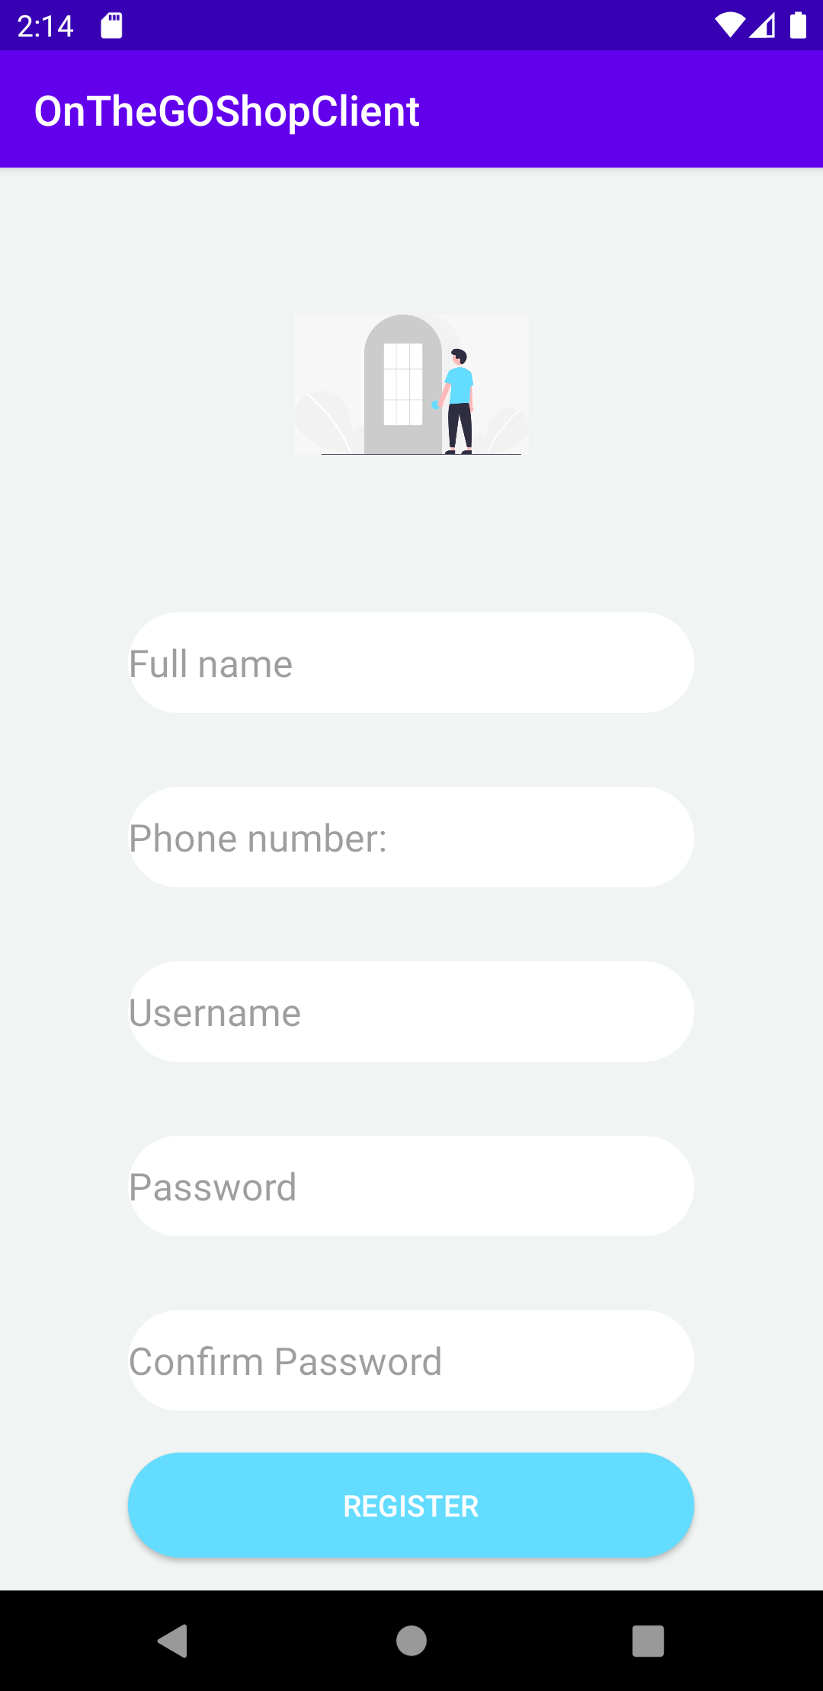
Flow of the app - register
The users can register in the app by filling the form.
An account will be created them and then they can log in and use the app as they please.
If some field is missing the app will show the user that there is something missing.

Slide 7
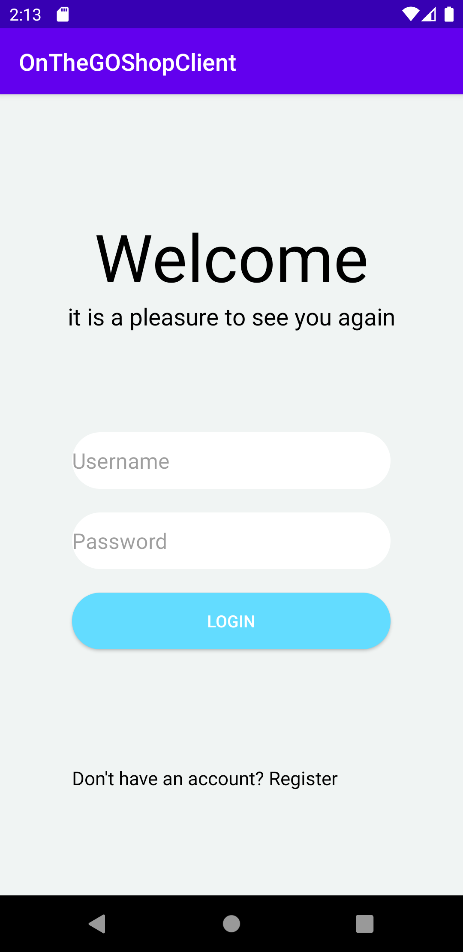
Flow of the app-login
In the app you can login as:
Manager
User
Driver
Users can register through the app.
Managers added manually.
Drivers added only by manger.

Slide 8
Flow of the app - user
As user you can select a product that you want and that will add the product to your cart.
You will be able to choose of all the products that we provide.
In cart you can choose the amount of the product that you want.
After you have created your cart you can place you order and that will move you to new activity where you can choose the location to which you want the order delivered.

Slide 9
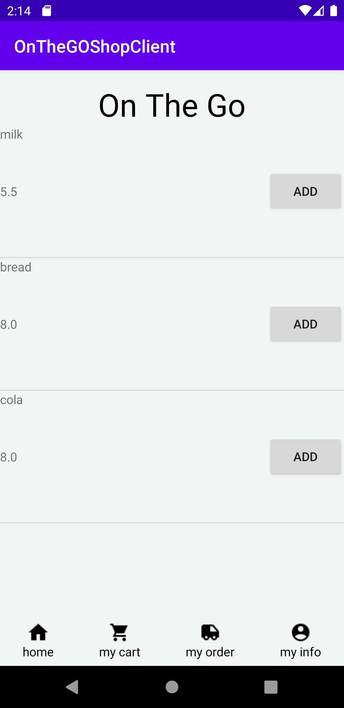
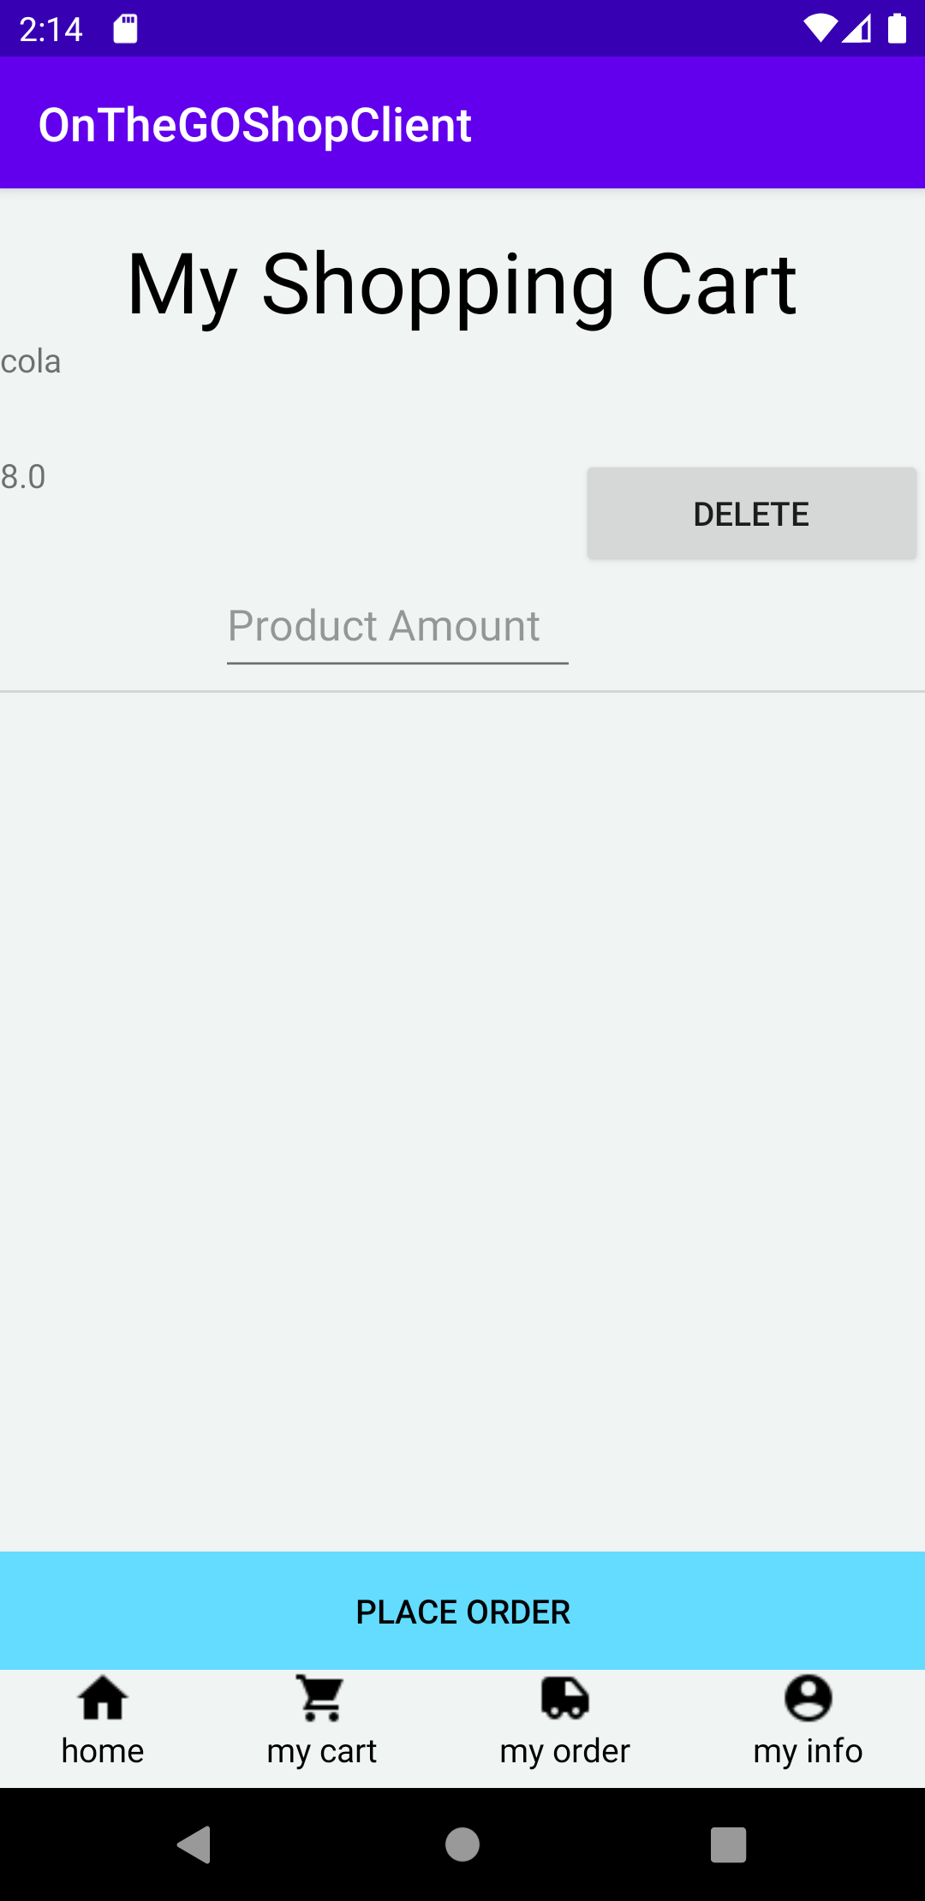
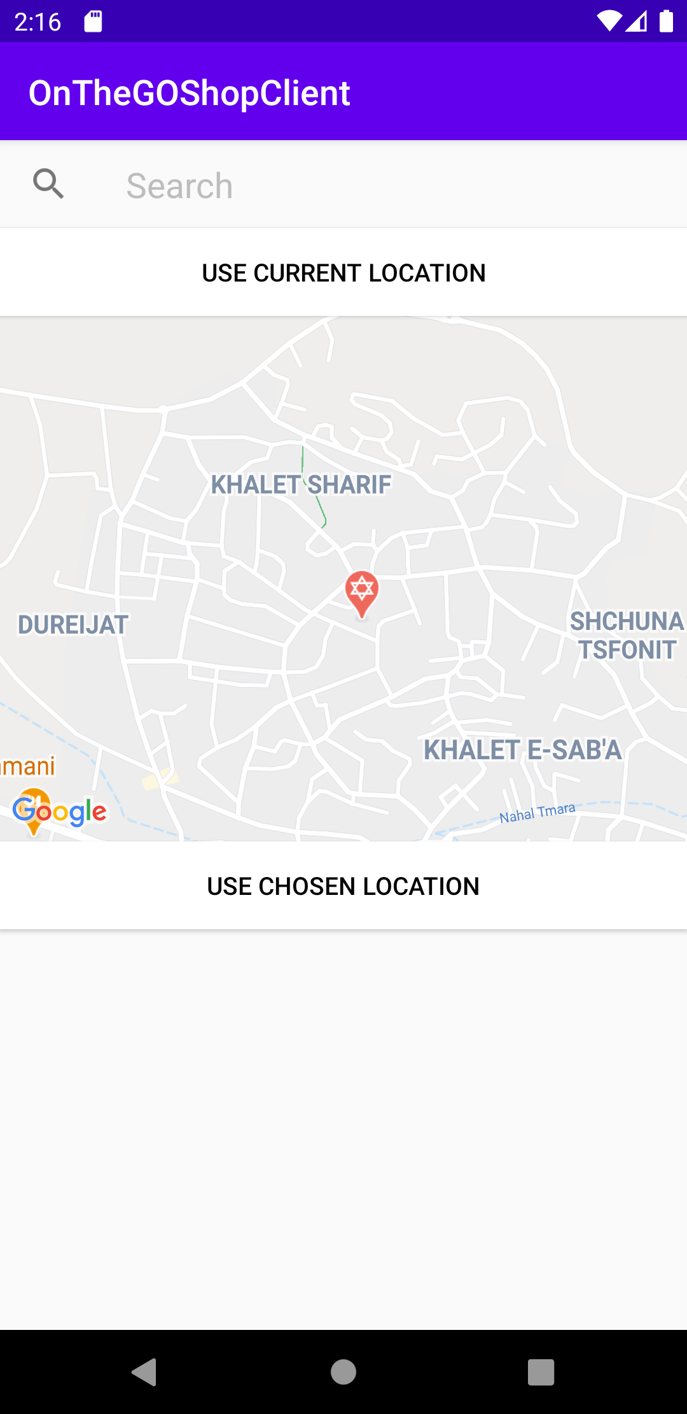
Flow of the App - ordering

Slide 10
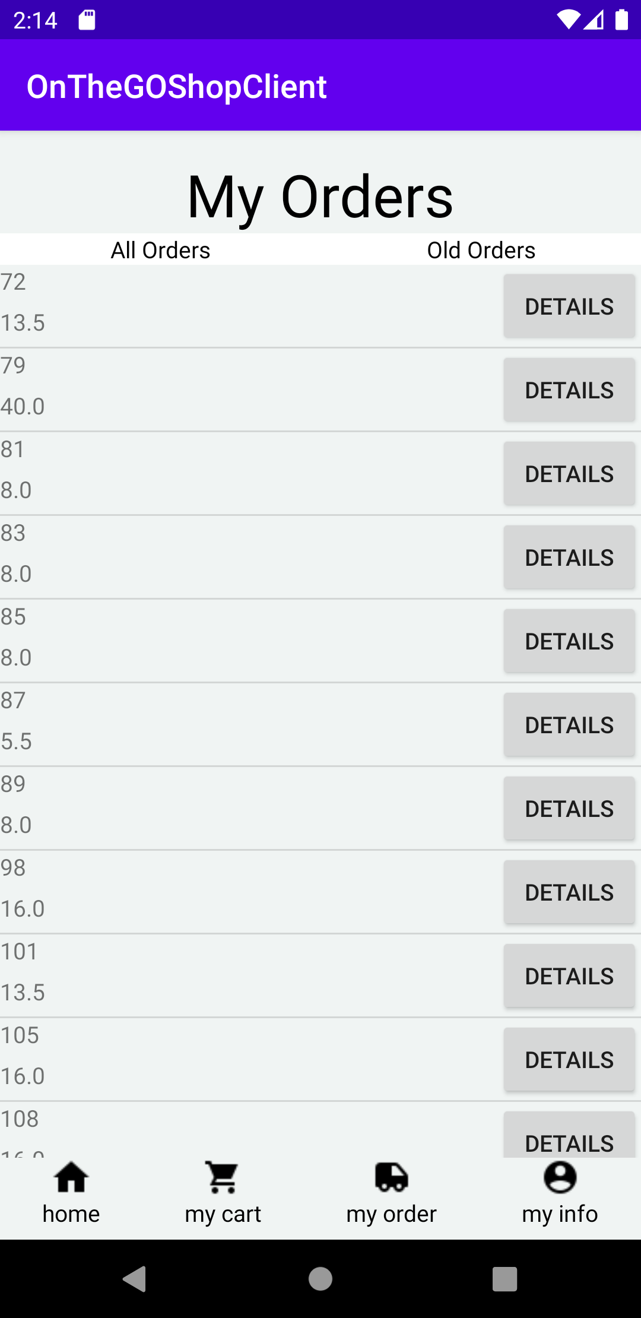
Flow of the app – Orders
After placing an order the user can view your orders.
The user will be presented by two options to see the orders that have been delivered or that they still have not.

Slide 11
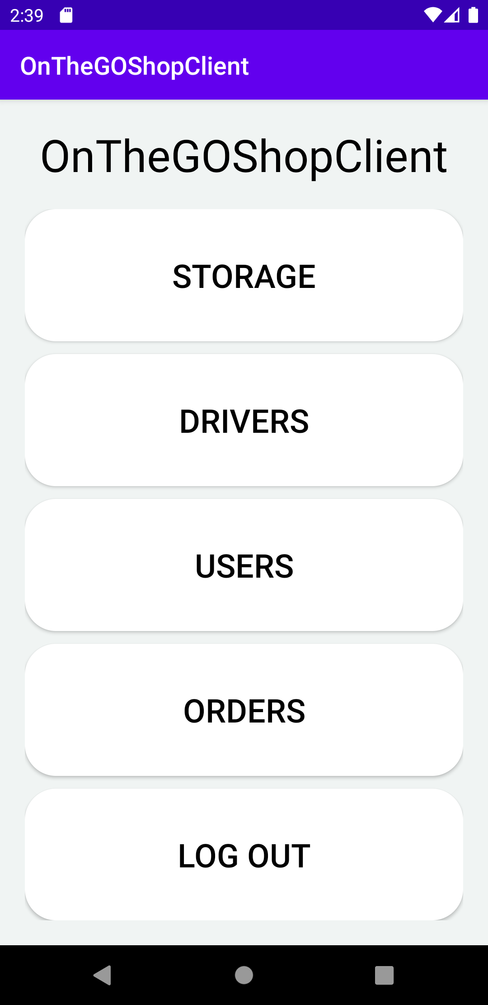
Flow of the app – Manager
On login as a Manager the manager will see what options he can see:
Storage
Drivers
Users
Orders

Slide 12
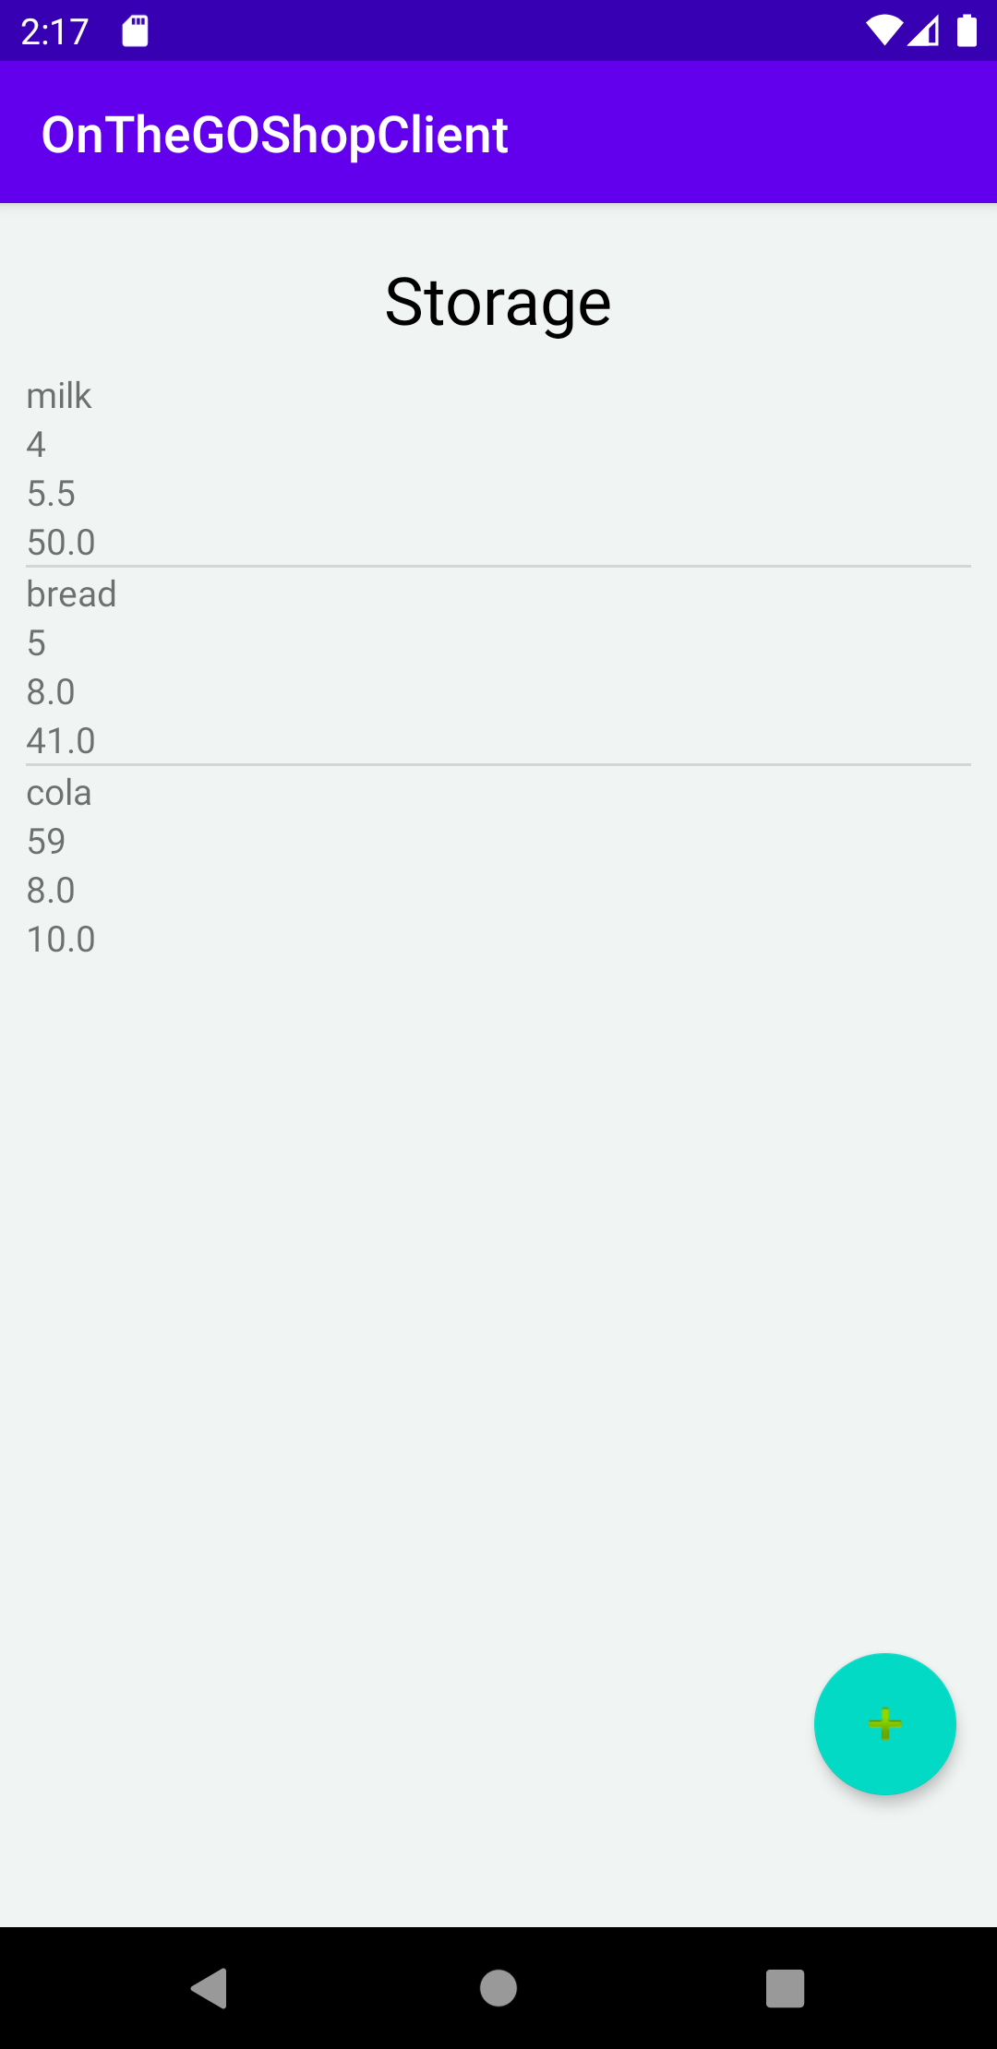
Flow of the app - Storage
The manager will be able to see all the products in the storage.
In this view he also have a + button upon clicking on it he will be sent to a new activity to add a new product or to add more amount.

Slide 13
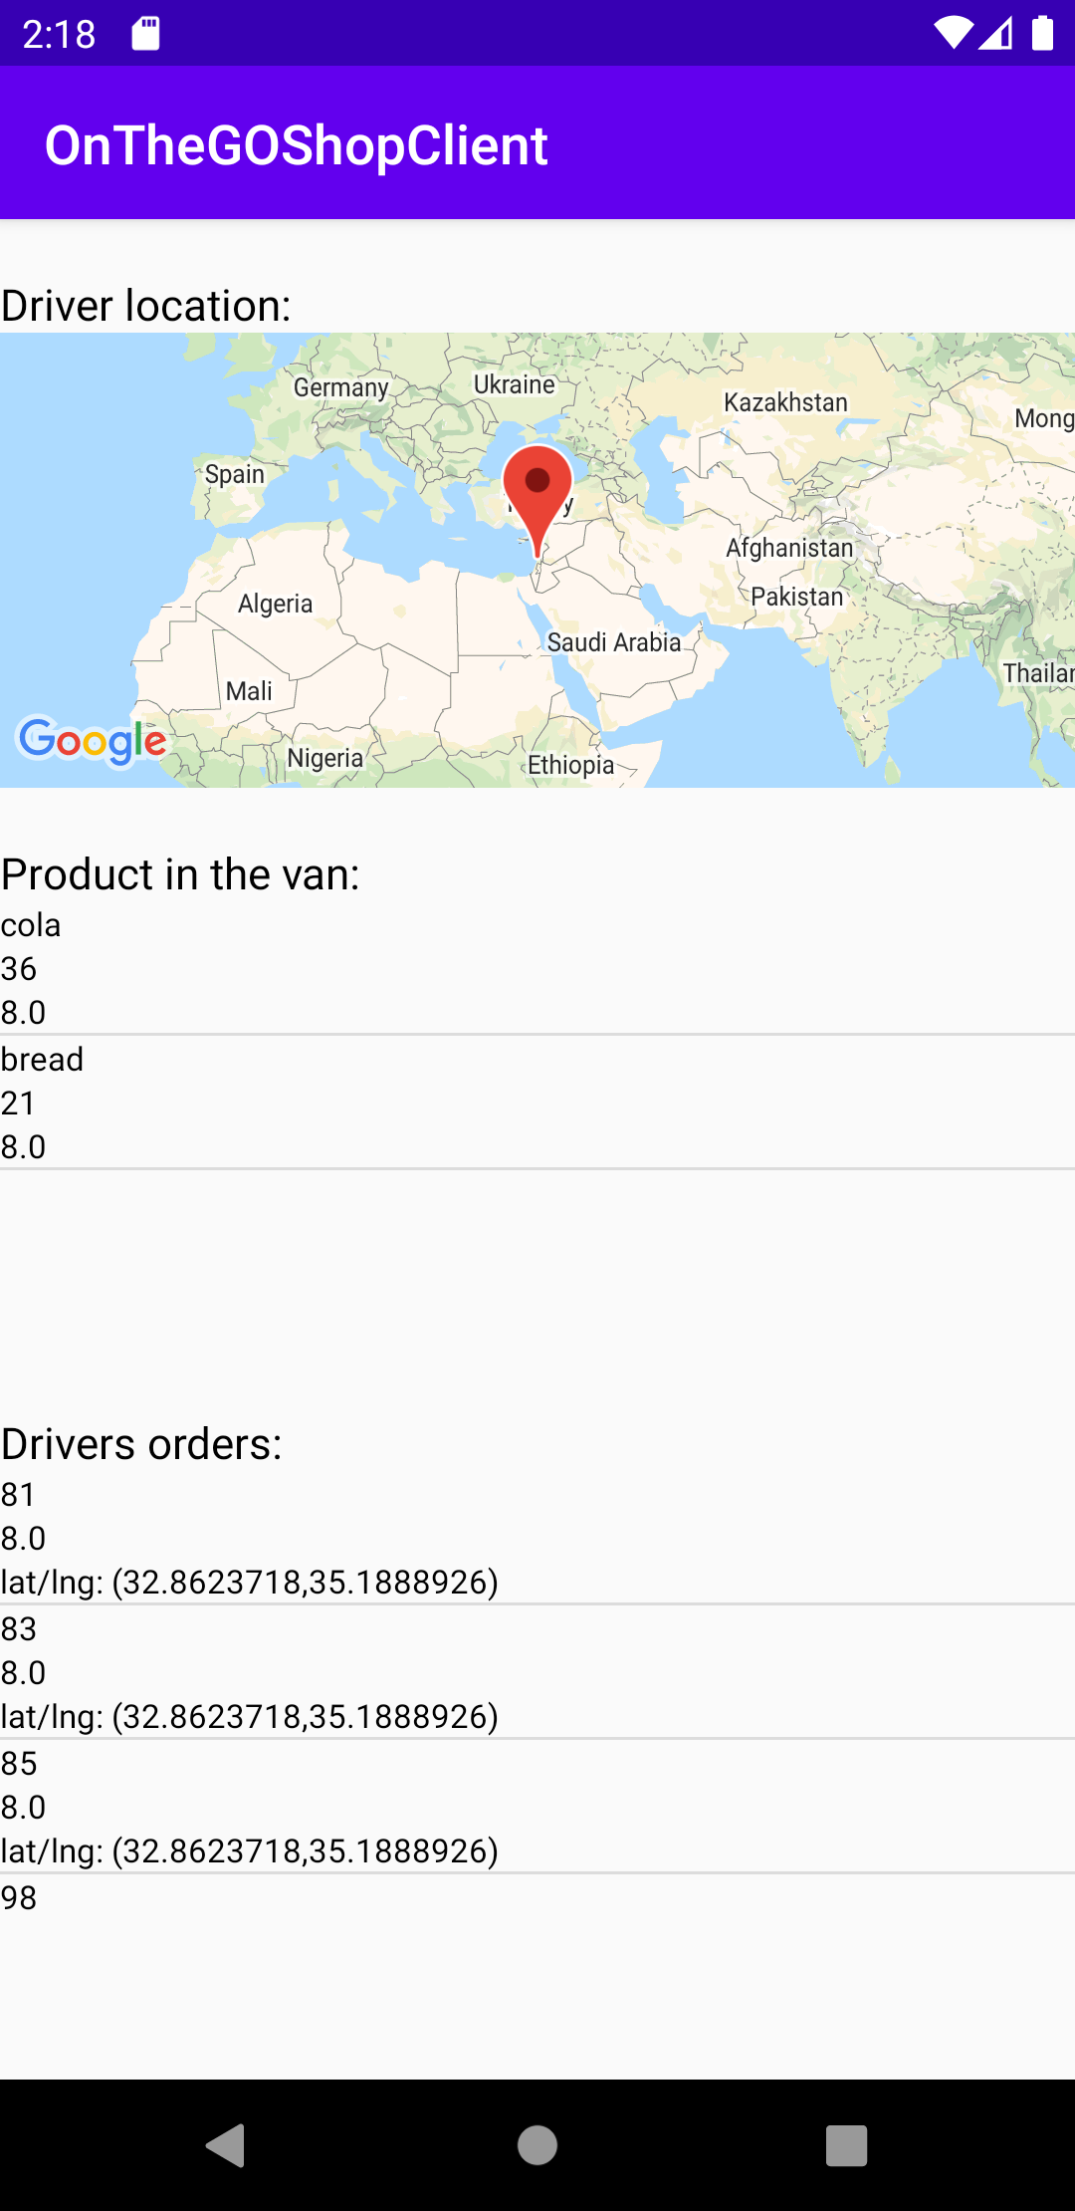
Flow of app - Drivers
Similar to the storage view the driver view have all the drivers.
A + button will be able to add a new driver with a van of his own.
The manger can also see the driver Info which include the real time location of the driver, the products in the van that the driver is driving and the order list that the driver have to deliver.

Slide 14
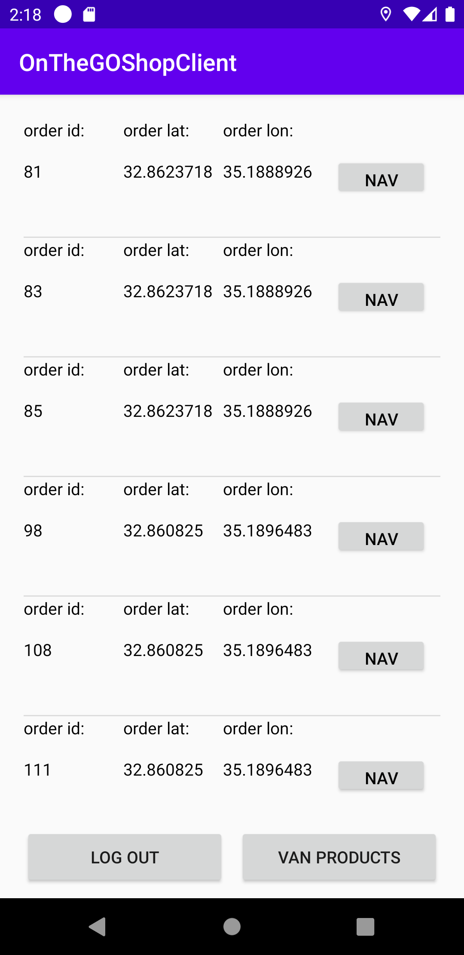
Flow of the app- Driver
When logging as driver the main view will be all the orders he have to deliver. Each order have a nav button that will give a navigation map to the order.
The orders will be sorted from the closest to him to the farthest.
He can also choose to see the products in the van.

Slide 15
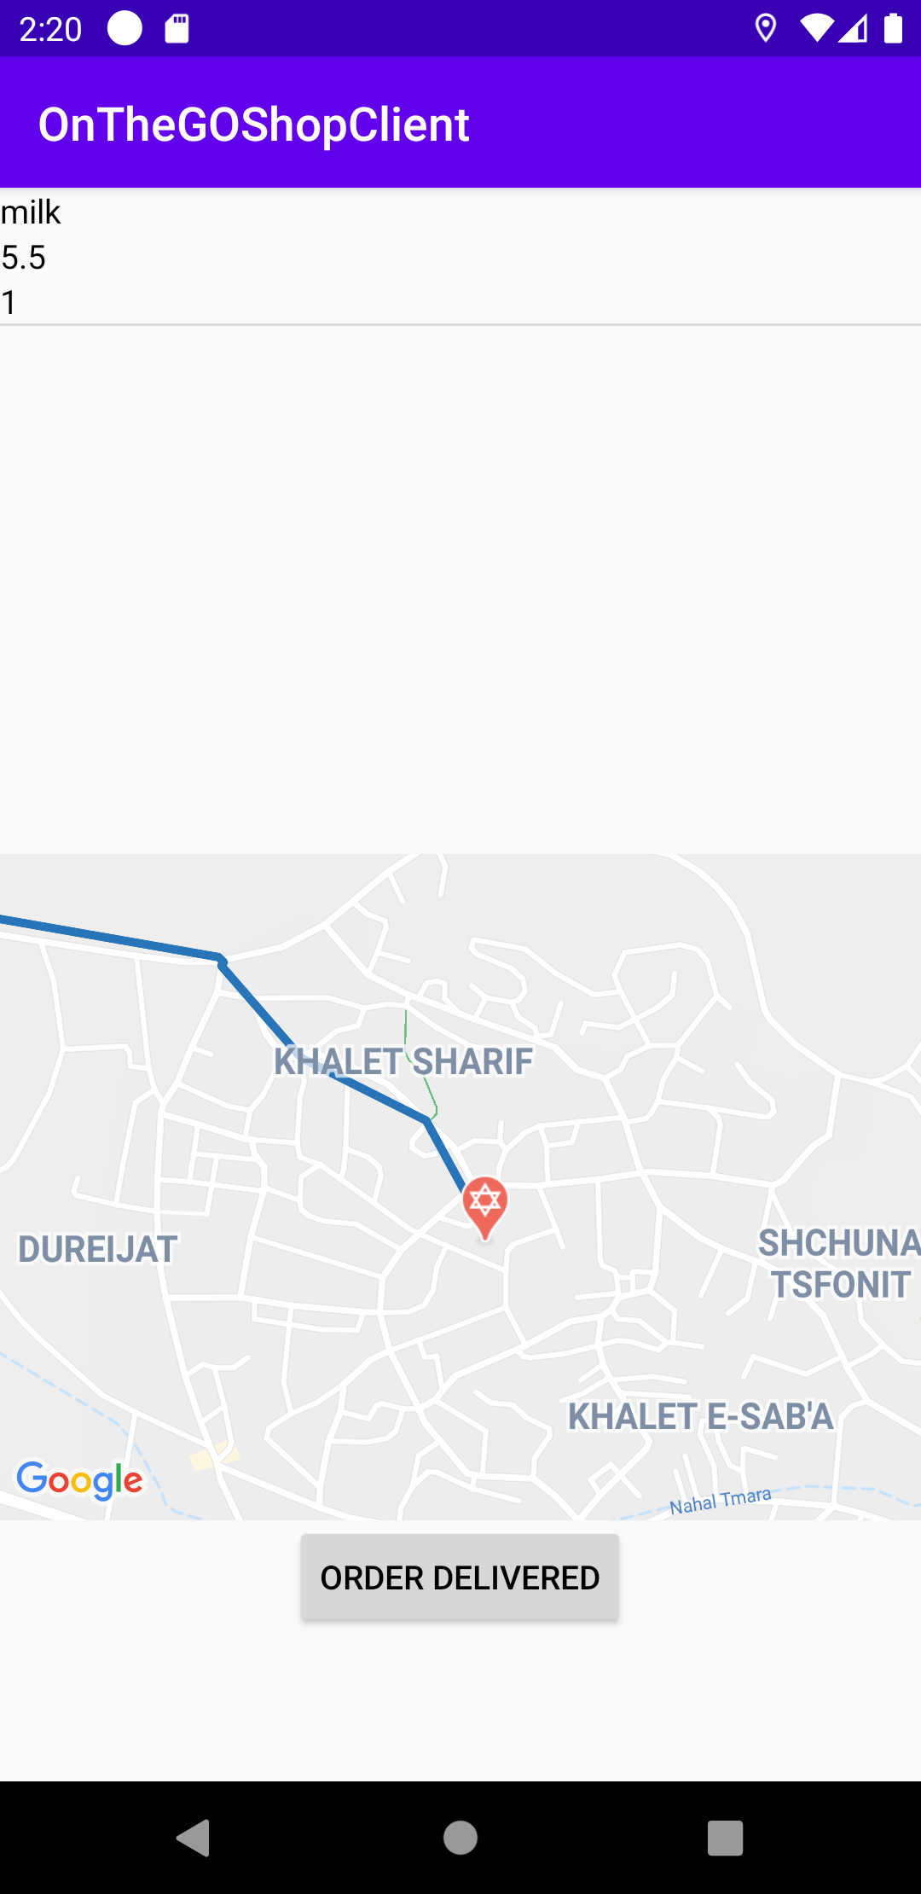
Flow of the app – navigate to the order
When choosing an order to navigate to the driver will be directed to a new view where he can see the products of the order and can see the map that have a direction to where the order must be delivered.
He will also be able to mark the order as delivered.

Slide 16
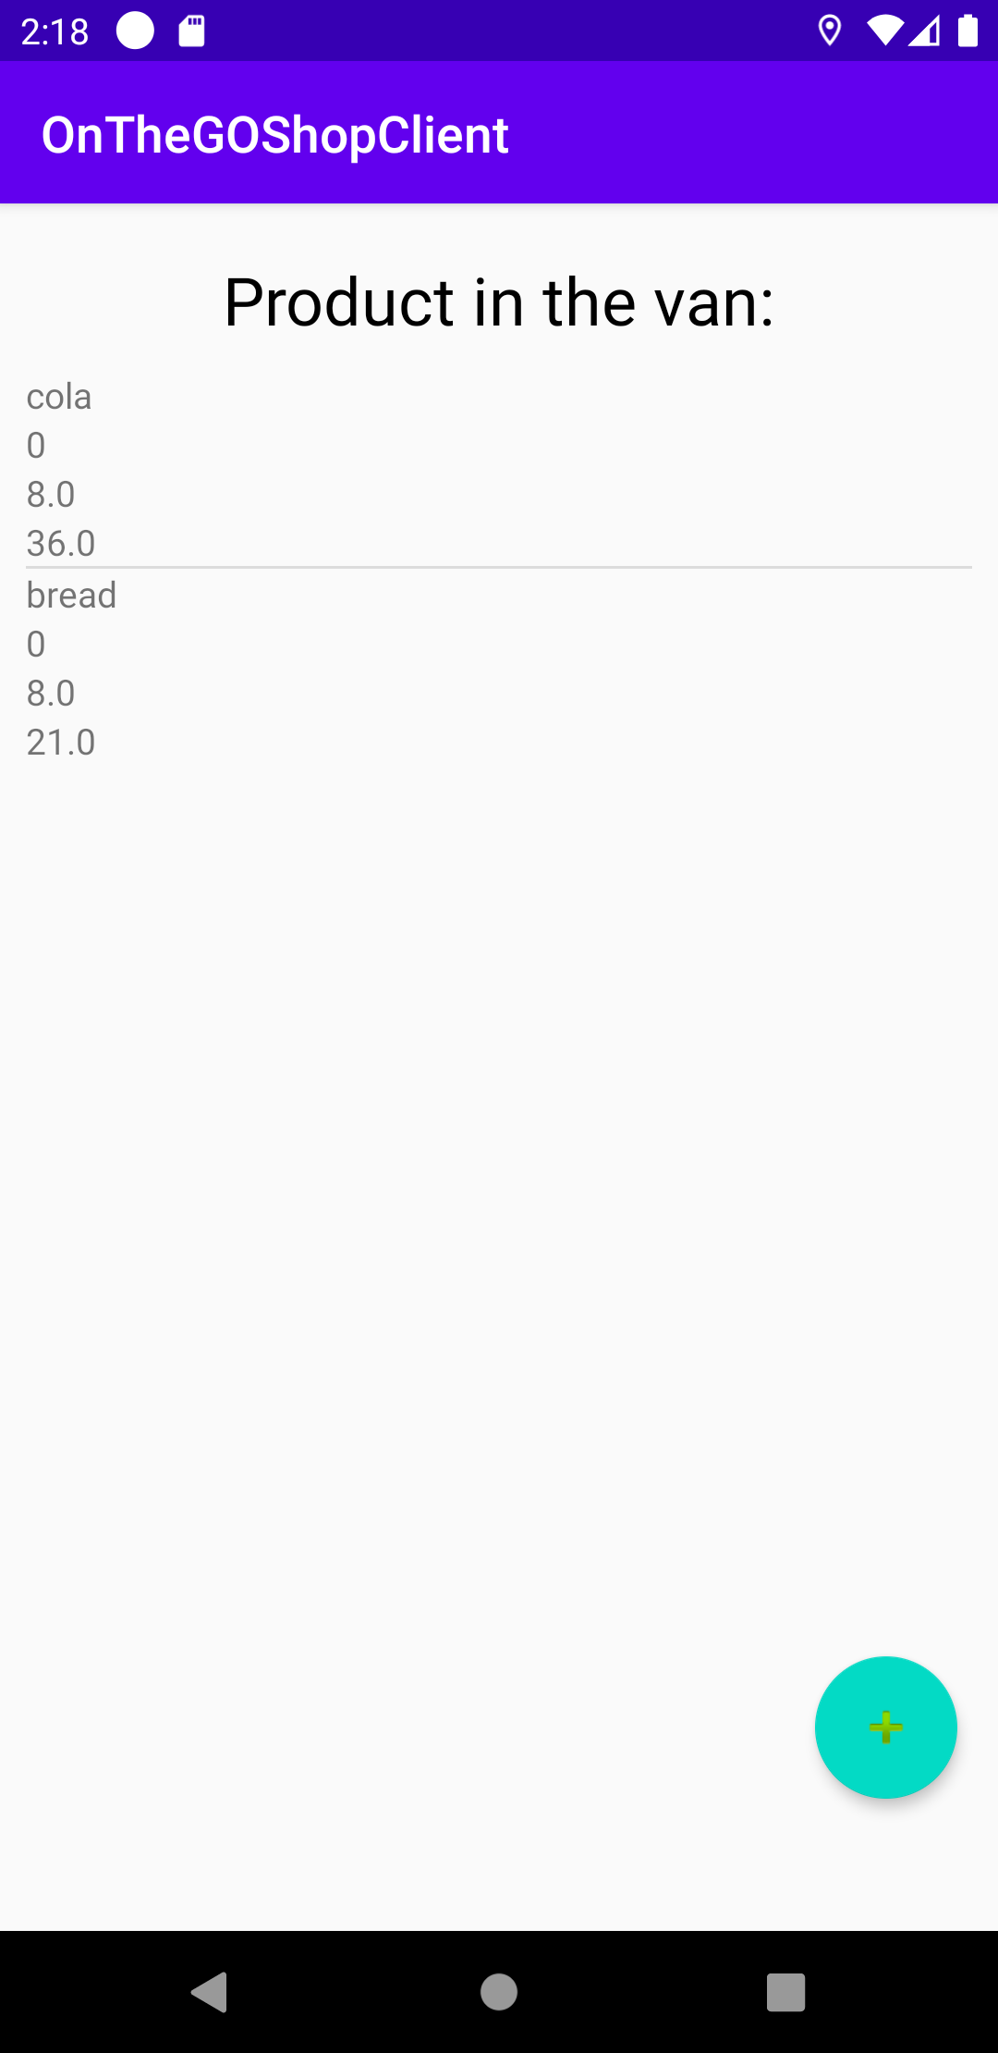
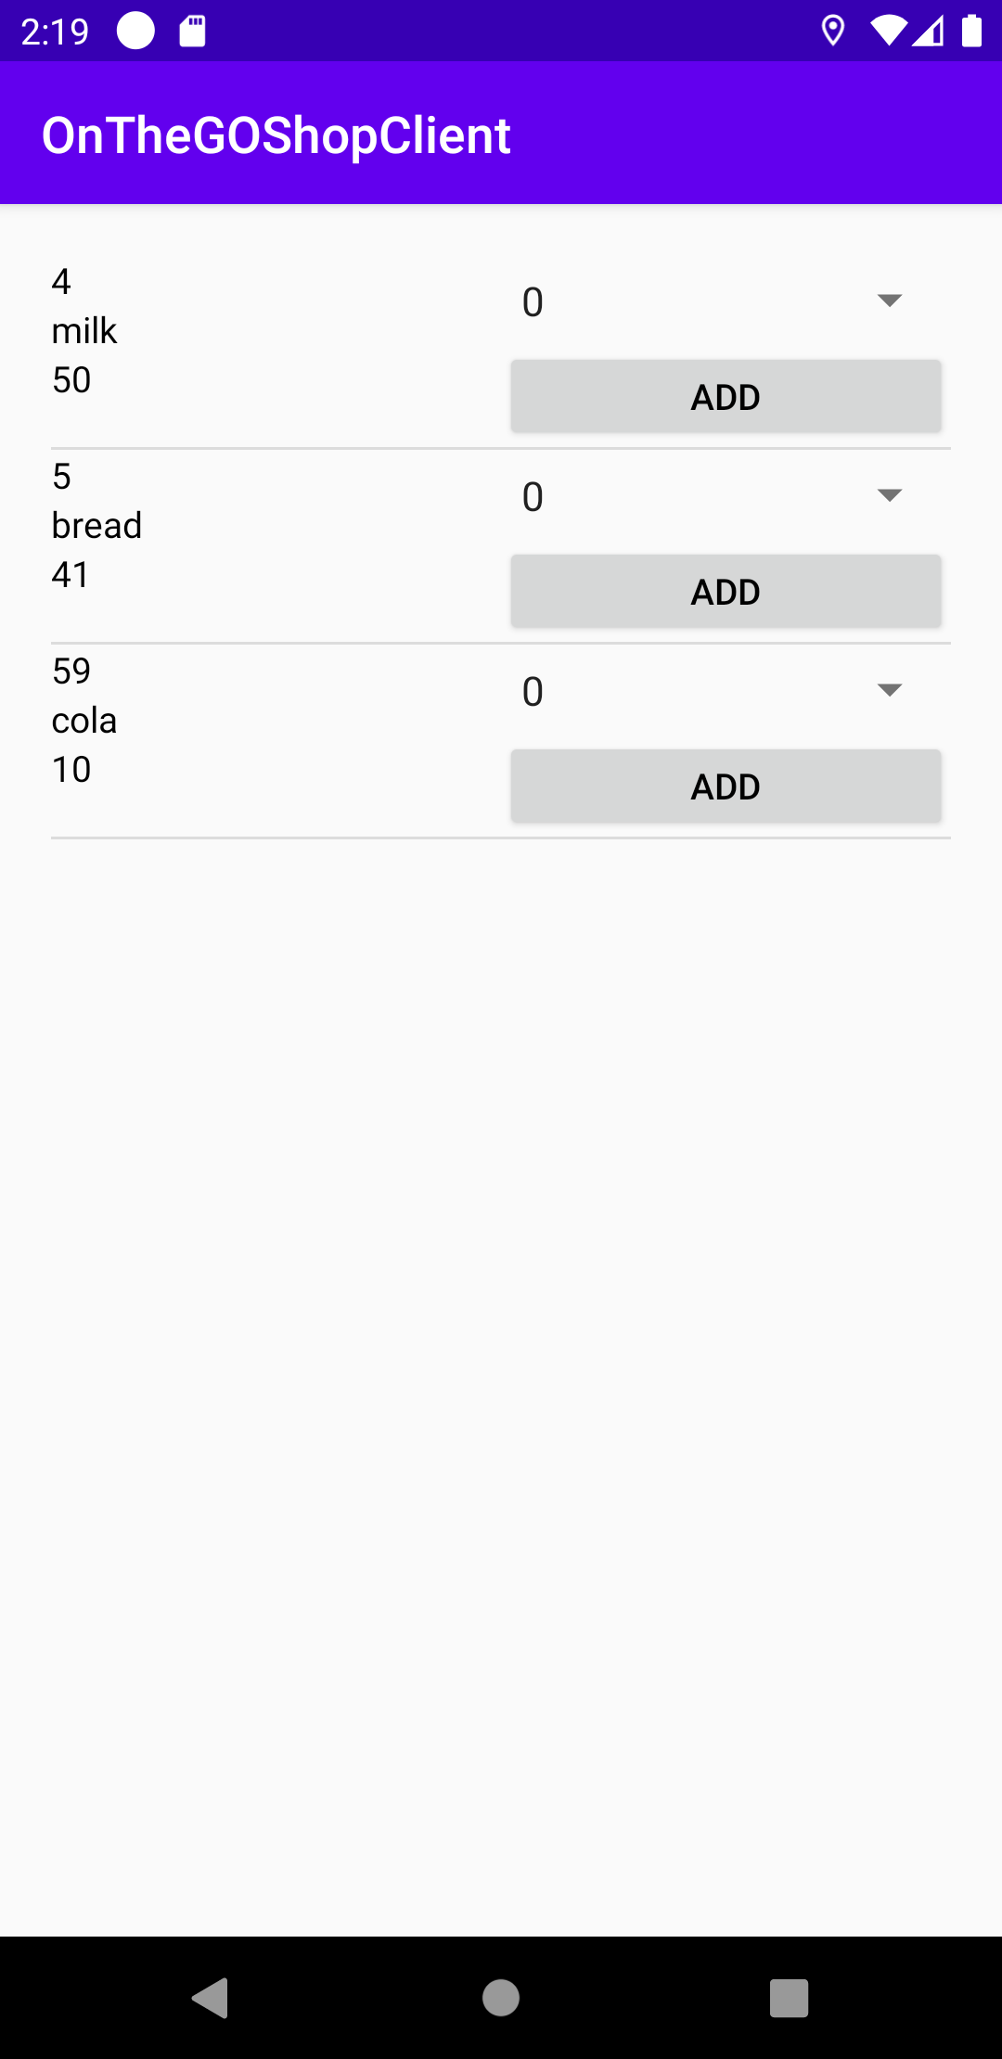
Flow of the app- van products
The driver can see the products in his van, and he can add products to his van.
He will only be able to add as much as in the storage he can’t add more than what exist in the storage of the shop.

Slide 17
Google maps and android
We used Google maps in our application:
In order to use google maps we needed to use the API provided by google.
We have created an API key generated by google services to be able to access their APIs.
Right now we are able to use the google maps, places and direction API using this key.

Slide 18
Services
We created A service for the users of type Drivers.
We wanted to keep up with the real time location of the driver.
To be able to keep our data correct we created a service that start on successful login of driver and will stop on closing the app.
The location is updated every 30 sec.

Slide 19
Requesting data from the server
The android application doesn’t have the data on the device
The data only accessible by the server so when in need of data the android send HTTP request to the server of the required data.
The when the server respond we then take the data analyze it and show it to the user.

Slide 20
Server
The server has communication with the database.
It is a web server, meaning that it receive a request by HTTP requests.
The server is where the data is manipulated and handled.
The server was developed using Spring Boot.

Slide 21
Why Spring Boot
Easy to understand and develop spring applications
Increases productivity
Reduces the development time
Simple scalability
Compatible with Containers

